Slide 1
SafeHire
AI-Powered Service Hiring Platform
Smarter Hiring for Safer Services
Afridur Rahman Khan Mim | Md. Zarif Hossain Alvi | Nazia Faruque Diya

Slide 2
Problem Statement
• Difficult to find reliable workers • Workers often unverified • No intelligent worker recommendation • Safety and trust issues in hiring
Afridur Rahman Khan Mim | Md. Zarif Hossain Alvi | Nazia Faruque Diya

Slide 3
SafeHire Solution
SafeHire provides worker registration, profile verification, job posting, and AI-based worker recommendation to ensure safer hiring.
Afridur Rahman Khan Mim | Md. Zarif Hossain Alvi | Nazia Faruque Diya

Slide 4
Platform Workflow
Register Worker
Verify Profile
Post Job
Hire Safely
Afridur Rahman Khan Mim | Md. Zarif Hossain Alvi | Nazia Faruque Diya

Slide 5
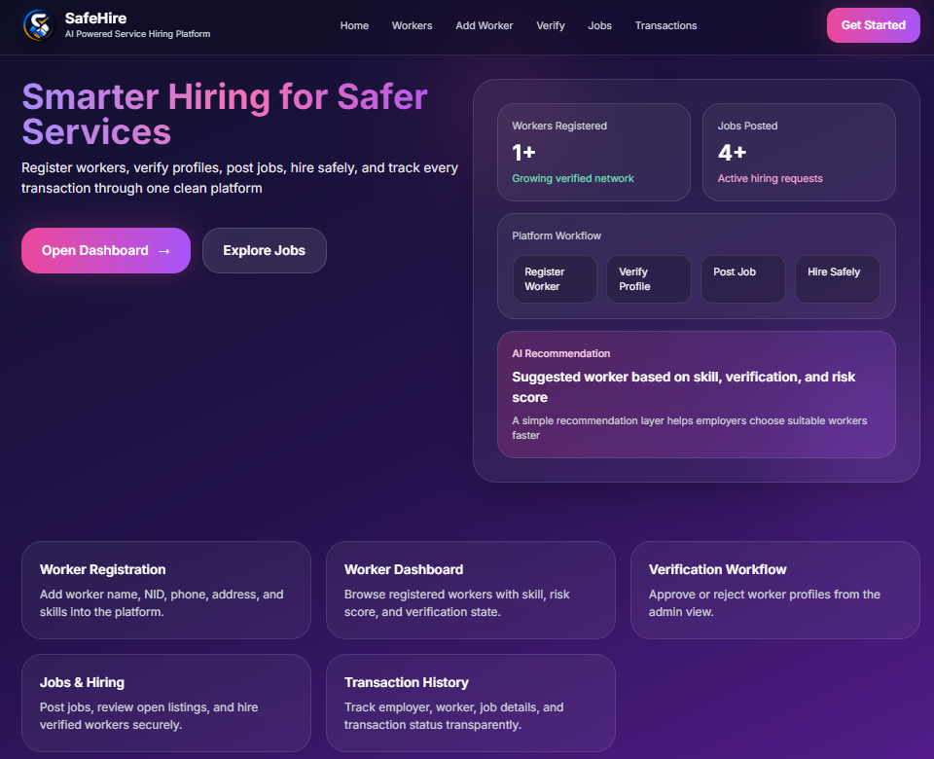
Home Page
Overview of the SafeHire platform dashboard
Afridur Rahman Khan Mim | Md. Zarif Hossain Alvi | Nazia Faruque Diya

Slide 6
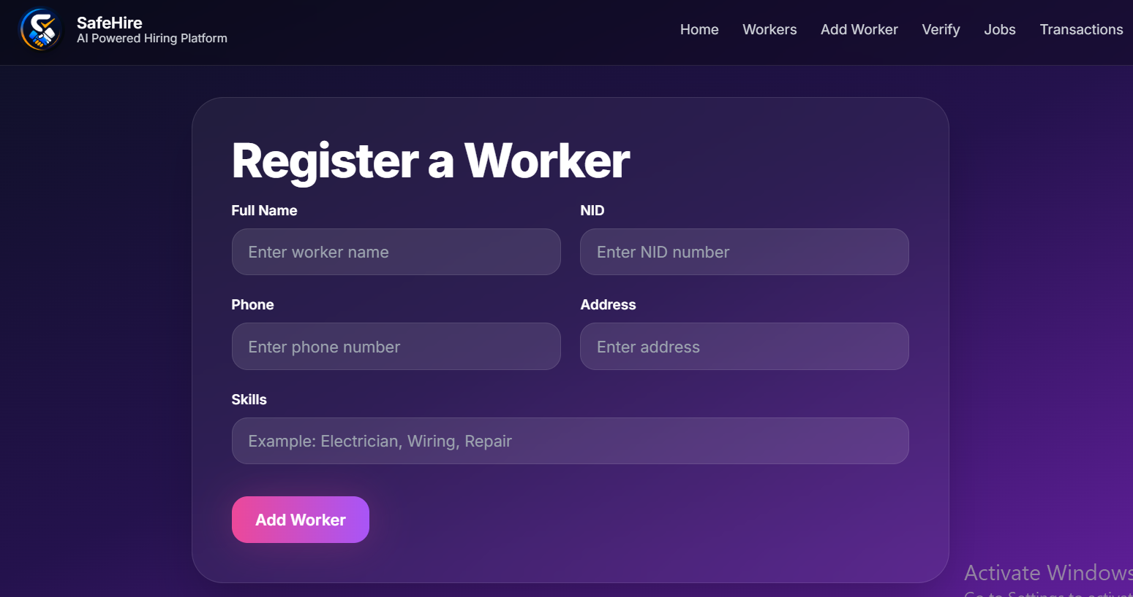
Worker Registration
Admin can add workers with NID, phone, address and skills.
Afridur Rahman Khan Mim | Md. Zarif Hossain Alvi | Nazia Faruque Diya

Slide 7
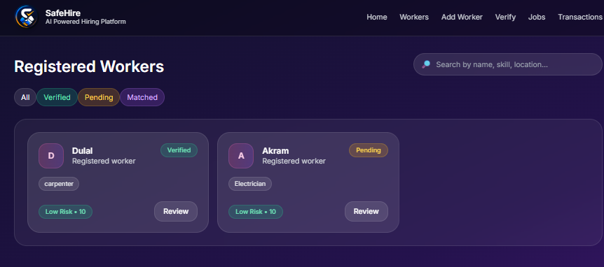
Workers Dashboard
View workers, skills, verification status and risk score.
Afridur Rahman Khan Mim | Md. Zarif Hossain Alvi | Nazia Faruque Diya

Slide 8
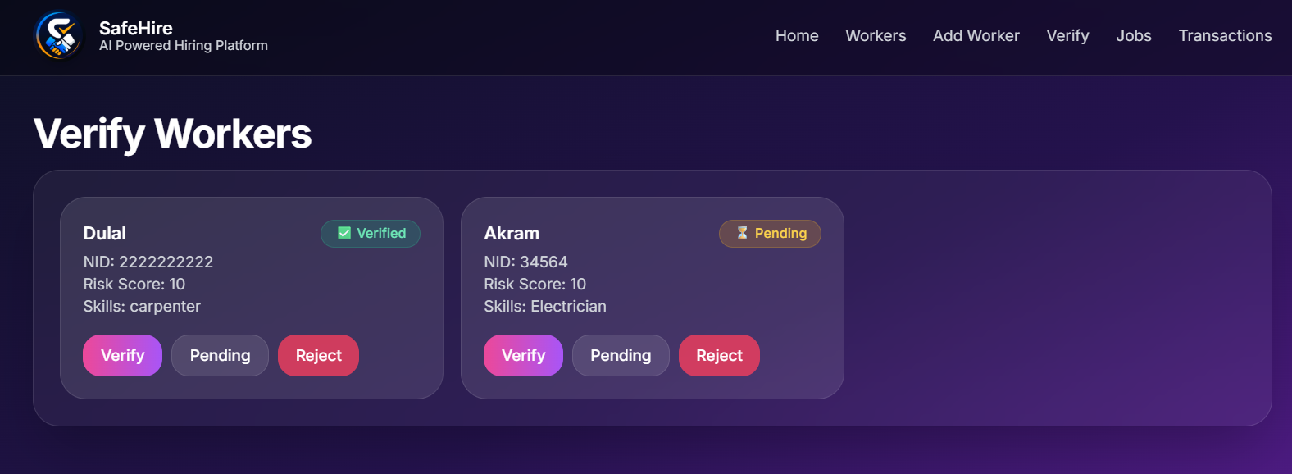
Worker Verification
Admin verifies workers before they are available for hiring.
Afridur Rahman Khan Mim | Md. Zarif Hossain Alvi | Nazia Faruque Diya

Slide 9
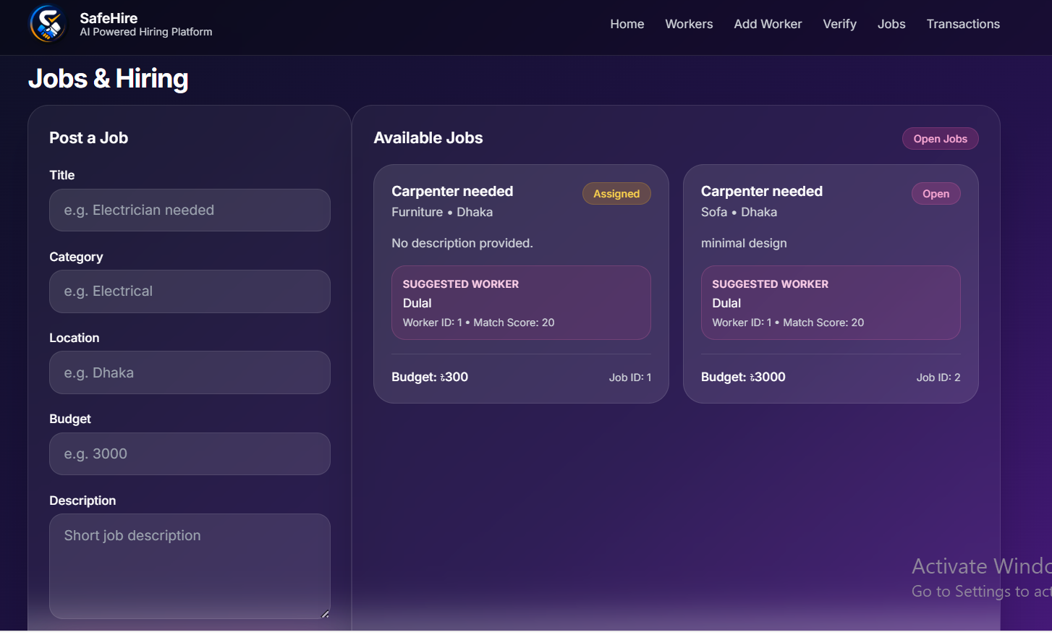
Jobs & Hiring
Employers post jobs and receive suggested workers.
Afridur Rahman Khan Mim | Md. Zarif Hossain Alvi | Nazia Faruque Diya

Slide 10
Conclusion
SafeHire improves trust and efficiency in service hiring.
THANK YOU!!!!
Afridur Rahman Khan Mim | Md. Zarif Hossain Alvi | Nazia Faruque Diya

